Slide 1
Course Summary

Slide 2
Agenda
Project
Final Exam information
Course summary
Case 9: R3
Consultation for Final Project

Slide 3
Final Project
1) An abstract within 150 words summarizing the main story; 2) A one-page introduction motivating the key question of interest and providing an overview for the rest of the report; 3) findings and rationales of the findings (with supporting materials and arguments); 4) broader implications of the findings.
Tables and graphs should be numbered and referenced in the manuscript.
References should be cited in the manuscript and listed alphabetically at the
end of the report (can choose any referencing style).
Page limit: three to five thousand words (not counting tables, graphs, or references).
Polish the language (e.g., Grammarly, ChatGPT)
Plagiarism is not allowed
Deadline: Dec 21, 2025 (11:59 pm)

Slide 4
Final Project
Include figures and tables
Make the solutions (e.g., technical and non-technical solutions) specific
to your questions/context
One or two paragraphs on broader implications
Item | Points
Completeness of main components | 10
Novelties of the topic (not novelties of the technology) | 20
The extent that the key question of interest has been addressed | 100
Clarity of writing and grammar | 10
Clarity of tables, graphs, and references | 10
Total | 150

Slide 5
Final Exam
Date: Dec 18 (9:30-11:30 am)
open-book exam (Face-to-face Final exam)
Students can bring the following hard-copy materials/aids:
o case studies
o slides
The exam has two parts.
  Section A. Short Answers (10 questions, 40 points): Provide concise and to-the-point
answers. This part is similar to assignment questions. (3 to 4 points for a question)
  Section B. Long Answers (8 questions, 60 points): 3 questions and a mini case study (5 questions). This part is similar to discussion questions of case studies. (6 to 15 points for a question)
Exam coverage:
  All slides, case studies, and assignments.
To review for the exam, you can
o review basic concepts from slides
o review case studies and assignments

Slide 6
Main topics of this course
Banking
  Basic concepts, digital banking
  Crowdfunding
  Payment System
Financial market
  Basic concepts
  Robo-advisory
  Retail and institutional trading
RegTech, Blockchain, InsurTech
 | Module | Topic | Cases/Guest |  | Assignments
1 | Introduction | Overview | - |  | Assignment 1
2 | FinTech in Banking | Bank(ing) digitization | Akbank
3 |  | Lending | Salary Finance |  | Assignment 2
4 |  | Payments | Ant Financial (A)
5 | FinTech in Trading | Capital market | Domeyard |  | Assignment 3
6 |  | Retail trading | Charles Schwab
7 |  | AI and big data | Guest Speaker
8 | Risk, Regulation, and Innovation | Risk Management | RegTech at HSBC |  | Assignment 4
9 |  | Innovation | Deutsche Bank (A)
10 |  | Insurance | Lemonade
11 | Course summary |  |  | R3 | -

Slide 7
Banking
Types of banks
  Commercial banks
  Investment banks
  Universal banks
What are the main business models for these banks?

Slide 8

Difference between commercial and investment banking

Slide 9
Banking
Why digital transformation in banks?
  Digital banking needs, Regulatory compliance needs, Cost saving?
  mini-case: HSBC
  Legacy systems
Why clouds for banks?
  Cloud adoption example
  Cloud security
Case 1: Akbank

Slide 10
Lending
Common loan attributes
Corporate loans
Unsecured credit (e.g., Credit cards)
Mortgages and other secured credit

Slide 11
Crowdfunding
Why crowdfunding?
Types of crowdfunding
Advantages and Risks of Crowdfunding

Slide 12
BNPL
Benefits of BNPL
Risks of BNPL
(online) Payday loans, Earned wage access
Case 2: Salary Finance

Slide 13
Main activities in payment processing
Payment instruction generation
  Specification of the fund transfer details by the payer
  E.g. the amount, payer, and payee’s account information
Clearing
  Process of providing payment instruction information to a clearing house
  The clearing house matches, reconciles, and sometimes nets the payment instructions
Settlement
  The transfer of cash or securities so that the transfer is final from a legal standpoint

Slide 14
Payment Technologies
Automated clearing house (ACH) transactions
US ACH is a store and forward payment system
ACH files are created by the originator are received by the ODFI and then forwarded to the ACH operator
The operator
Verifies that the formatting is correct and sets the settlement date value
Extracts entries from the ODFI files, sorts, and groups according to the destination RDFI
Generates RDFI-specific ACH files and makes them available for download by the
RDFI
Historically has been next-day payments, but moving to same-day and, ultimately, immediate payments

Slide 15





Capital Market
Institutional Customers
Financial Intermediaries
Execution Venues
Liquidity Providers
Pension Funds
Clearing Brokers
Exchanges
Market Makers
Insurance Companies
Non-clearing Brokers
ECNs
Hedge Funds
Market Participants
Hedge Funds
Dark Pools
Prop Trading Operations
via financial
intermediaries
Mutual Funds & Unit Trusts
Other Participants
Clearing Houses
Central Counter-parties
Source: Duran, R. E., Financial Services Technology, Cengage Learning Asia, 2018
Custodians
Central Securities Depositories
Retail Customers
Regulators

Slide 16
Capital Market
Retail investors
Institutional investors
  Banks
  Insurance companies
  Pensions
  ETFs
  Mutual funds
  Hedge funds
Algorithmic Trading
  Time-weighted average pricing (TWAP) algorithms
  Volume-weighted average (VWAP) pricing algorithms

Slide 17
Capital Market
Trading System Architectures
  Order routing system components
  Direct market access (DMA)
On exchange VS off-exchange
Exchanges processes and data
  order messages, order type
  on exchange matching and off-exchange matching
  circuit breakers
  surveillance
Liquidity providers
  Designated market makers, Proprietary traders
HFT
Case 4: Domeyard

Slide 18
Retail Trading
Why do retail investors underperform?
FinTech for retail investors
  Online trading
  Robo-advisor
  Tech-enabled information democratization
Brokers vs dealer
Services by brokerages
Case 5: Charles Schwab Corp

Slide 19
AI and big Data
Regulatory issues related to AI
  AI application in risk management
Application programming interface (API)
  API applications
  Risks of open APIs
Open banking
  Different policies across countries
Robotic process automation (RPA)
Alternative data in Fintech industry

Slide 20
Risk Management
Types of risk
  Market risk (measurement)
  Market liquidity risk
  Credit risk
  Settlement risk
  Operational risk
  Compliance risk
Compliance Risk Management
RegTech
  Main RegTech services
  technologies
Case 6: RegTech at HSBC
20

Slide 21
Innovation
Innovation
  Strategies of innovation (In-house R&D VS Outsourcing innovation)
  Regulations
Distributed ledger technology
  Blockchain (structure and mechanics)
  Smart contract
  DLT applications
  Characteristics and challenges
  Cryptocurrency (Bitcoin)
Case 7: Deutsche Bank

Slide 22
Insurance
Insurance
  Key ingredients of insurances
  Types of insurance
  Challenges
  Regulations
InsurTech
  IoT
  AI, machine learning
  Digital service delivery
Case 8: Lemonade

Slide 23
Case 9: R3

Slide 24
R3
https://r3.com/company/
https://www.youtube.com/watch?v=wZLf5C6P16I https://www.youtube.com/watch?v=K_2QhtTBN8U https://www.youtube.com/watch?v=zDX0TJuOWj0

Slide 25
Q1: How does R3’s distributed ledger technology help mitigate the gap between finance and technology?
Industry-specific design:Corda is customized for the financial industry to meet the unique needs and regulatory constraints of financial institutions. This domain-specific design ensures that the technology is more aligned with the needs of financial services.
Privacy and Confidentiality:R3's DLT maintains privacy and confidentiality by ensuring that only “need-to-know” participants have access to transaction data. This is critical for financial institutions that handle sensitive information.
Interoperability:By providing a common platform, Corda enables different financial institutions to interact and transact seamlessly, regardless of their internal systems. This interoperability helps standardize processes across the industry.
Smart Contracts:Corda integrates smart contracts, which are self-executing protocols where the terms of the contract are written directly into the code. This feature allows for automated processing of financial agreements, reducing the need for manual intervention and increasing efficiency.
Regulatory Compliance:Built for regulatory compliance, the platform allows real-time monitoring of financial activities, which helps financial institutions meet regulatory requirements more efficiently.
Risk Reduction:By having a shared, tamper-proof ledger, DLT reduces counterparty risk as agreements are encoded and enforced across the network, ensuring that all participants fulfill their agreed obligations.
Improve operational efficiency:DLT can simplify and automate complex financial processes such as clearing and settlement, reducing time from days to seconds and improving liquidity and capital efficiency.
Reduce fraud:DLT's security features, including cryptographic signatures and consensus mechanisms, minimize fraud by making it difficult for fraudulent activity to escape detection.
On-demand data sharing:Corda's design allows data to be shared only with the participants directly involved in the transaction, which is more consistent with how financial institutions manage sensitive data.
Permission Chain:Unlike public blockchains, Corda operates as a permission chain, meaning access is limited to known and trusted participants, in line with the security and control requirements of financial institutions.
Flexibility and customization:Financial institutions can develop and deploy customized applications on the Corda platform based on specific business scenario requirements, enabling personalized business processes and customer experiences.
Open source platform:By releasing Corda as an open source platform, R3 encourages collaboration and innovation within the financial
industry, allowing banks and other institutions to build their own applications on the platform.
25

Slide 26
Q2: What are the key differences between Corda and traditional blockchain platforms?
The main differences between Corda and traditional blockchain platforms are reflected in the following aspects:
1. Privacy andData sharing mechanism: Corda: adopts the “need-to-know” principle, where only the participants associated with the transaction can access the transaction data, and does not broadcast the data across the global network. Traditional Blockchain: such as the Bitcoin Blockchain, where all participants have access to all transaction data in the network.
Consensus mechanism: Corda: Instead of being based on Proof of Work (PoW) consensus mechanism, it uses more refined consensus mechanisms, such as Practical Byzantine Fault Tolerance (PBFT) and Raft, to reach a consensus only between interested parties.Traditional Blockchain: usually requires all nodes in the network to reach consensus on the order of transactions, e.g. Bitcoin uses the PoW mechanism.
Smart Contracts: Corda: supports smart contracts, allowing business logic to be embedded in contracts for automatic execution. Traditional Blockchain: while smart contracts are also supported, Corda's smart contract design focuses more on compatibility with and enforcement of legal contracts.
Distributed Ledger Type: Corda: is a Permissioned Ledger, meaning that only authorized nodes can participate in the network. Traditional Blockchain: can be either a Permissioned Ledger or a Permissionless Ledger, which allows any node to join the network. 6.
Architectural Design: Corda: Designed as a platform for distributed applications (DApps), supporting complex business logic and multiple consensus algorithms. Traditional Blockchain: while also supporting DApps, Corda's design is more focused on financial transactions and contract enforcement.
Performance and Scalability: Corda: may have better performance and scalability as transactions are processed only between relevant nodes. Traditional Blockchain: all nodes need to process and store all transactions, which may affect performance and scalability.
Legal and regulatory adaptations:Corda: designed with legal and regulatory requirements in mind, making it easier for financial contracts and transactions built on Corda to comply with regulatory requirements. Traditional Blockchain: while decentralized, may require additional work to adapt to legal and regulatory requirements in different jurisdictions.

Slide 27
Recall: Blockchain: structure and mechanics
Key components
  A network protocol that supports communication between participants
  A network of computers that store and manage transaction data
  A process for managing records that is based on achieving consensus between participants
Records are maintained on many different computers, “nodes”, within the network
Nodes coordinate with one another to maintain the consistency of the distributed ledger
Permissionless blockchain implementations allow open access to the distributed ledger
Permissioned blockchain implementations limit who can participate in the network

Slide 28
Q3: Could R3 gain recognition and expand its business in China?
Yes — R3 can gain recognition and expand its business in China, but it’s not a guaranteed or friction-free path. Its prospects depend on how well it aligns with China’s specific regulatory, technological, and ecosystem priorities.
R3, the global enterprise blockchain consortium best known for its Corda distributed ledger technology, has already seen early engagement with Chinese institutions — for example, Ping An Group became one of the first Chinese members of the R3 consortium back in 2016. That step showed significant interest from a major domestic financial player in exploring shared ledger applications with R3 participants.
There’s also historical precedent of Chinese financial systems like the China Foreign Exchange Trade System (CFETS) joining R3’s efforts to develop distributed ledger applications for regulated finance.
LeapRate
Those moments matter because China approaches blockchain not through speculative public crypto rails but through “联盟链” (permissioned or consortium blockchains) aligned with regulatory goals. China’s strategy has tended to favor domestic standards and platforms like FISCO BCOS (a Chinese financial blockchain consortium) and the Blockchain-based Service Network (BSN), which provide infrastructure tailored to local compliance requirements.
This means R3’s expansion would likely succeed most not by competing directly with China’s homegrown networks, but by:
Collaborating technically with Chinese financial institutions that want interoperable enterprise DLT systems (as Ping An and CFETS have shown interest).
Adapting Corda or R3 solutions to comply with China’s regulatory frameworks that emphasize control, data sovereignty, and permissioned blockchain ecosystems.
Aligning with national blockchain initiatives like BSN China, which hosts multi-chain development environments and could bridge enterprise projects with regulated deployments.
China’s policy environment favors innovation within regulatory guardrails, especially for finance, supply chain, and identity systems. Foreign tech players and alliances can participate if they align with those priorities, but they typically cannot operate independently outside Chinese legal and infrastructure norms. This means R3’s strategy would need to localize — in partnerships, governance models, and technical integrations — to expand recognition and business there.

Slide 29
Q4: What are the potential applications of Corda to other
industries?
Supply Chain Management: track the movement of goods and services throughout the supply chain, ensuring transparency, reducing fraud, and improving efficiency.
Real Estate: Corda can streamline property transactions by providing a secure and transparent platform for recording land titles, property deeds, and other legal documents.
Healthcare:Corda can help manage patient records, ensuring data privacy and security while allowing authorized access to medical history across different healthcare providers.
Intellectual Property and Copyright Management:Corda can be used to register and track intellectual property rights, such as patents, trademarks, and copyrights, providing a transparent and immutable record of ownership.
Energy Trading: Corda can facilitate peer-to-peer energy trading, allowing parties to transact directly without intermediaries, and automating the settlement process.
Insurance:Corda can automate insurance claim processing through smart contracts, which can trigger payouts automatically when certain conditions are met, reducing fraud and speeding up claim resolution.
Government Services: Corda can be used to manage government records, such as birth certificates, marriage licenses, and voting systems, increasing the integrity and efficiency of public services.
Legal and Notary Services: Corda can provide a secure platform for managing legal documents, contracts, and notarizations, ensuring the authenticity and non-repudiation of documents.
Charity and Non-Profit Sector:Corda can enhance transparency in the charity sector by tracking donations and ensuring that funds are used for their intended purposes.
Manufacturing and Quality Control:In manufacturing, Corda can track the provenance of materials and products, ensuring quality control and compliance with industry standards.
Logistics and Transportation:Corda can be used to coordinate and track shipments across multiple parties, reducing disputes and improving the efficiency of logistics operations.
Telecommunications:In the telecom industry, Corda can manage roaming agreements and settlements between different service providers. Identity Verification:Corda can provide a secure and privacy-preserving system for verifying identities, which is useful in various sectors, including finance, healthcare
Education and Academic Records:Corda can securely store and verify academic records and qualifications, preventing fraud and simplifying the
verification process for employers and educational institutions.
29

Slide 30

Course evaluation
https://onlinesurvey.cityu.edu.hk

Slide 31
Consultations for Final Project

Slide 32
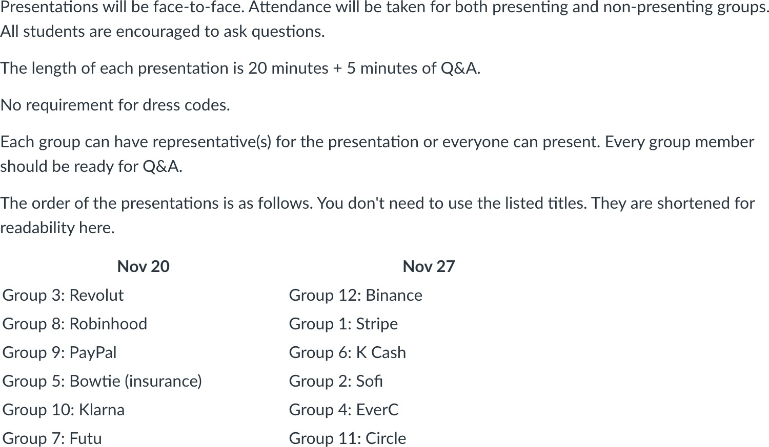
In-class Consultations (each group has 6-8 mins)

